Slide 1

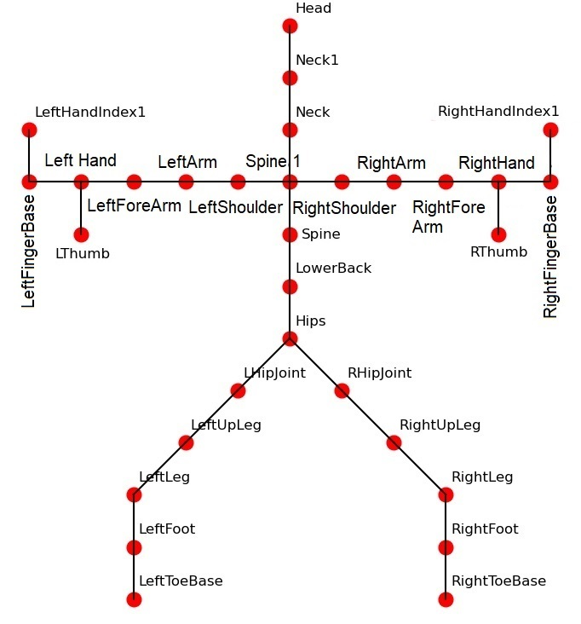
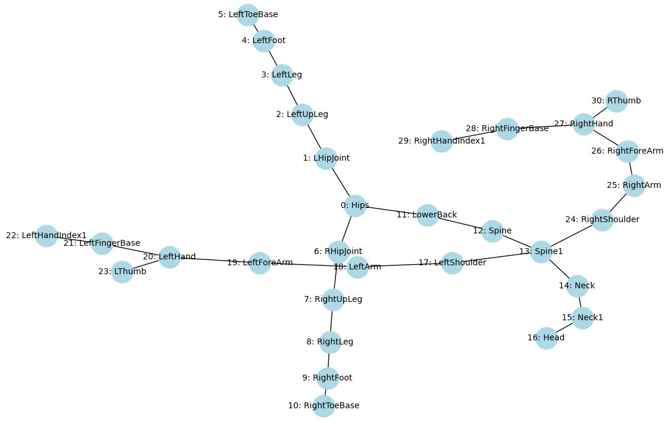

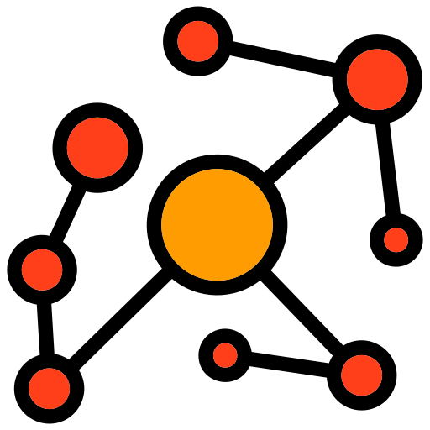
Action and Emotion Recognition by Graph Convolutional Network (GCN)
Instructor - Cesare Alippi
TAs - Tommaso Marzi and Gabriele Dominici
Presenter – S. M. Hossein Mousavi
May 2024

Slide 2

Outline
Introduction
Action and Emotion Recognition
Emotion Recognition Modalities
Body Motion Modality
Xia Dataset
Graph Convolutional Network (GCN)
The Contribution
Results
References

Slide 3

Introduction
Importance [1]
GDL methods offer a deeper understanding of the data structure by capturing subtle details of the input.
Also, it can handle irregular data structures like body skeletons in which each joint (or node in the graph) can have a varying number of connections to other joints.
It normally leads to higher accuracy by capturing the complex relationship of the data (extracting relevant features of edges and joints).
Challenges
Feature extraction is always a problem in traditional methods
Even algorithms such as CNN, which extract features, can’t handle different data structures and handle everything grid-like
Older methods can’t handle irregular data structures of the human body perfectly.

Slide 4
Introduction
Solution
To extract just meaning full features automatically exactly based on the data structure as a graph.
To avoid unnecessary computation due to having more understanding of the data structure.
To handle irregular shapes of the body more effectively, by mapping skeletal data into graphs.
Drawback
The data structure for input must be extracted and defined.

Slide 5
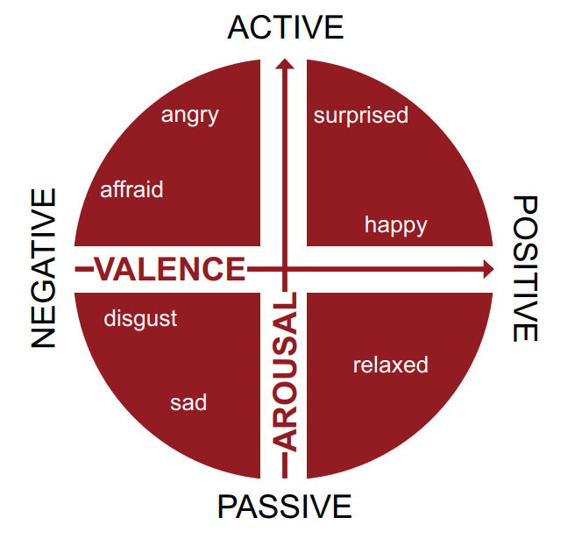

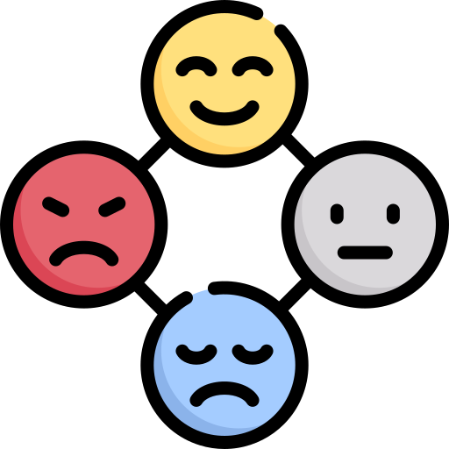
Action and Emotion Recognition
Action Recognition (AR):
It involves using machine learning and pattern recognition to classify human actions such as walking, running, jumping, and more.
Emotion Recognition (ER):
The same techniques are used to determine subjects’ emotional states, such as neutral, anger, joy, and more.
In Body Motion:
Body motions are sequential frames of bodily movement over time, which consist of joints and connected bones/edges.
By investigating joint angles, positions, rotations, and the relationships between these joints and edges, actions and emotions could be interpreted [2].
Ekmanian ER Model
Joy
Anger
Sadness
Fear
Disgust
Surprise
Neutral
Ekmanian ER Model 2-D Arousal Valance ER Model [3]

Slide 6


Action and Emotion Recognition
Some AR Applications are:
Security
Sport
Physical Therapy
Entertainment
Smart Home
Some AR Challenges are:
Variability in Actions
Real-Time Processing
Data Scarcity
Privacy Issues

Slide 7
Action and Emotion Recognition
Some ER Applications are:
Healthcare
Automotive
Education
Security
Marketing
Some ER Challenges are:
Variability in Expression
Subtlety of Emotional Expressions
Data Scarcity
Privacy Issues

Slide 8


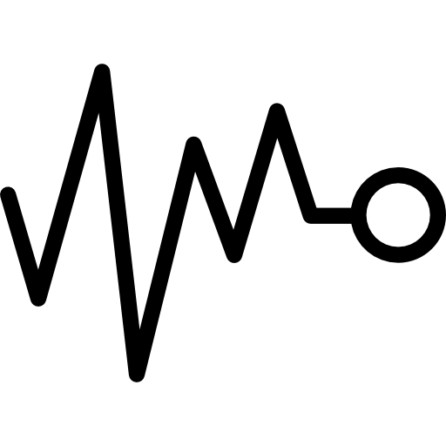



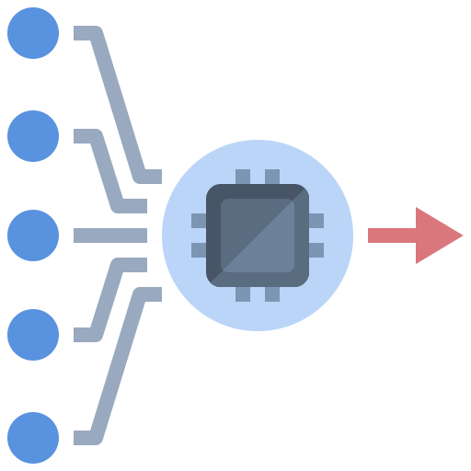
Emotion Recognition (ER) Modalities [4]
Facial Expressions: Image – Change in Facial Wrinkles
Vocal Expressions: Sound Signal – Change in Vocal Tone
Physiological Signals for ER: Vector Signal – Ratio of the Sudden Change
Text-Based ER: String – Change in Writing Style
Eye Gaze and Pupil Dilation for ER: Vector Signal – Change in Eye Direction or Pupil Size
Body Motion for ER: Motion Matrix – Change in Body Posture

Slide 9
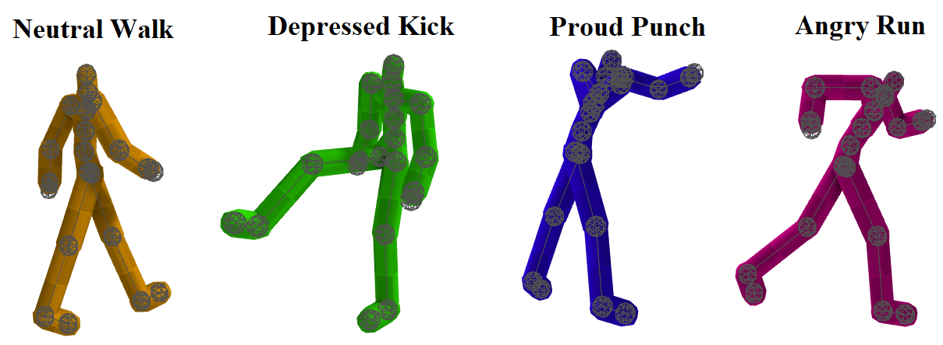

Xia Dataset
Structure:
11 Min in 572 Samples and Four Subjects
BVH Format and 32 Body Joints
Recorded by Vicon optical motion capture system
Five Actions of Walking, Running, Jumping, Kicking, Punching
Emotions of Neutral, Proud, Angry, and Depressed.
Publicly Available by Link
Samples of the Xia dataset generated by BVHView software

Slide 10


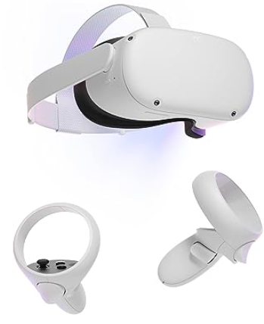
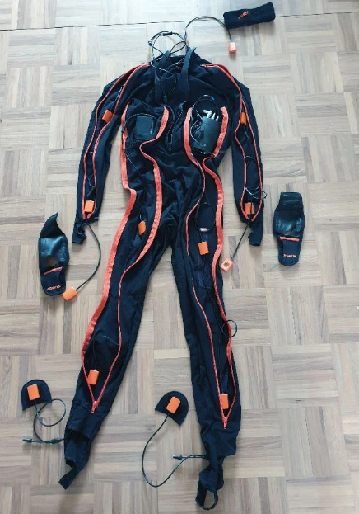

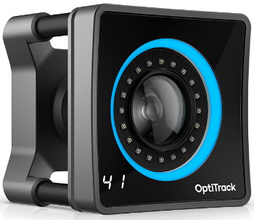
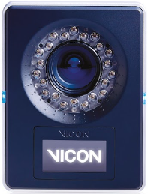

Body Motion
This data type is easily collectible with normal cameras or motion capture technologies; in the latter case, individual identity won't be revealed.
Normal color sensors: Extracting body joints and edges by algorithms.
Any smartphone or digital camera.
Mocap infrared sensors: These are the same as color sensors, but subject's identity is secured.
Kinect, OptiTrack, and Vicon.
Mocap Wearable sensors: Same as above, and the most precise and the subject's identity is secured.
VR headset and handheld controller and Xsens.
Smartphone-Digital Camera Kinect - OptiTrack - Vicon VR headset - Xsens

Slide 11

Body Motion
BioVision Hierarchy (BVH) file [5]: BVH file format stores motion capture data in the form of position and rotation of joints over time.
It has a hierarchical skeletal structure of the body in which each joint has a name.
A lot of software like Blender and Maya use it as animation files.
Skeletal structure of the Xia dataset samples

Slide 12
Graph Convolutional Network (GCN) [6-8]
GCN extends the concept of convolution, traditionally used to process grid-like data (such as images), to operate on graphs.
This allows GCNs to effectively capture the relationships and interactions between nodes (entities) in a graph.
Powerful tools for tasks involving networks, such as social network analysis, molecular structure analysis, and body skeleton.
GCN Input:
For instance, it is feature matrix X and an adjacency matrix A.
X contains the feature vectors of each node in the graph, with dimensions [N×F], where N is the number of nodes and F is the number of features per node.
A represents the connections between nodes, with dimensions [N×N], where a value of 1 indicates a connection between nodes, and 0 indicates no connection.

Slide 13
Graph Convolutional Network (GCN)
GCN Convolution Layers:
A graph convolution layer updates the feature vector of each node by aggregating features from its neighbors and its own features, often using the adjacency matrix A and a set of learnable weights. All followed by ReLU.
Hidden Layers:
A GCN can have multiple graph convolution layers stacked to learn increasingly abstract representations of the graph data. Tasks such as dropout, normalization, and attention mechanism.
Output Layer:
The final layer of a GCN transforms the learned representations into the desired output format, which can be node-level predictions (e.g., node classification). It is fully connected.

Slide 14
Graph Convolutional Network (GCN)
Training Loss Function:
GCNs are trained using gradient descent to minimize a loss function, adjusting the weights W to improve the model's predictions.
Why GCN in Body Motion?:
Applying GCNs to classify body motion resembles the natural graph structure of human anatomy, where joints and limbs can be represented as nodes and edges, respectively.
By understanding these relationships, GCNs can accurately classify various types of body motions, benefiting applications in sports science, physical therapy, and human-computer interaction.
For emotion recognition, it is superior for subtle movement representing emotions over other methods.

Slide 15

The Contribution
Defining joint and body skeletal structure
Loading the dataset for Action/Emotion
Interpolating the number of frames to the maximum to have unified samples
Converting body skeleton to graph
Defining GCN model structure
The recording node features and edge list
T-SNE plot of Nodes
Splitting dataset to 70 % train and 30% test
Training the model
Testing the model
Piloting results (acc/loss plot, classification report, and confusion matrix)

Slide 16
The Contribution
Defining joint and body skeletal structure
Joint_Names (31) = [
"Hips", "LHipJoint", "LeftUpLeg", "LeftLeg", "LeftFoot", "LeftToeBase", "RHipJoint", "RightUpLeg", "RightLeg", "RightFoot", "RightToeBase", "LowerBack", "Spine", "Spine1", "Neck", "Neck1", "Head", "LeftShoulder", "LeftArm", "LeftForeArm", "LeftHand", "LeftFingerBase", "LeftHandIndex1", "LThumb", "RightShoulder", "RightArm", "RightForeArm", "RightHand", "RightFingerBase", "RightHandIndex1", "RThumb"
]
Pairs of joints that form the skeleton's connections
Skeletal_Connections (28) = [
("Hips", "LHipJoint"), ("LHipJoint", "LeftUpLeg"), ("LeftUpLeg", "LeftLeg"),
("Hips", "RHipJoint"), ("RHipJoint", "RightUpLeg"), ("RightUpLeg", "RightLeg"),
("RightLeg", "RightFoot"), ("RightFoot", "RightToeBase"),
("Hips", "LowerBack"), ("LowerBack", "Spine"), ("Spine", "Spine1"),
("Spine1", "Neck"), ("Neck", "Neck1"), ("Neck1", "Head"),
("Spine1", "LeftShoulder"), ("LeftShoulder", "LeftArm"),
("LeftArm", "LeftForeArm"), ("LeftForeArm", "LeftHand"),
("LeftHand", "LeftFingerBase"), ("LeftFingerBase", "LeftHandIndex1"),
("LeftHand", "LThumb"),
("Spine1", "RightShoulder"), ("RightShoulder", "RightArm"),
("RightArm", "RightForeArm"), ("RightForeArm", "RightHand"),
("RightHand", "RightFingerBase"), ("RightFingerBase", "RightHandIndex1"),
("RightHand", "RThumb")
]

Slide 17
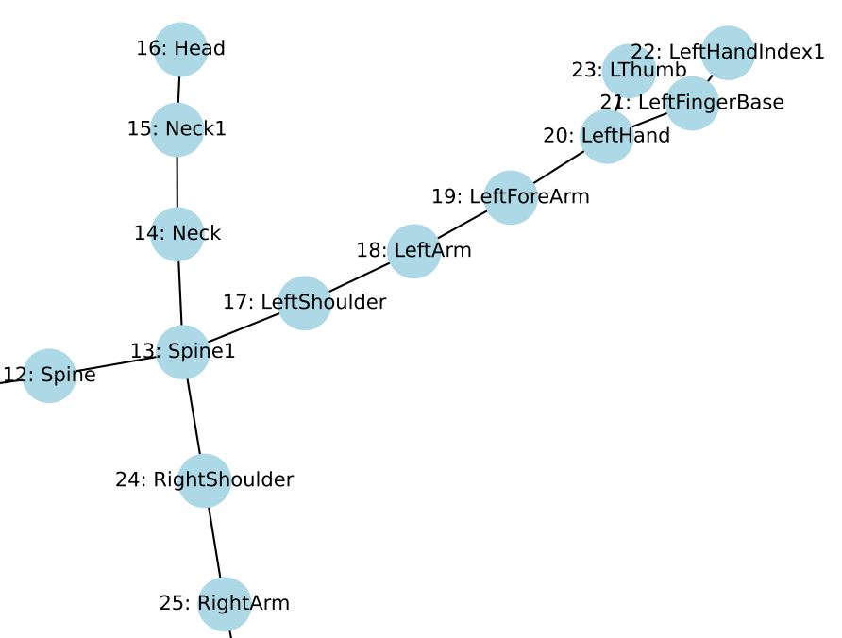
The Contribution
Converting body skeleton to graph
Graph nodes represent body joints
Edges represent skeletal connections
Node in body motion is the multiplication of the number of body joints by the number of frames
Node features are descriptions of nodes/joints (how many ways a node/joint could be described)
For instance, 3000*1000 means there are 3000 nodes which each could be described in 1000 ways
Edges are connections of joints multiplied by the number of frames
For instance, 2*3000 means we have 3000 edges, and each row represents two nodes connection
If the first column is [0, 1], it indicates there is an edge from node 0 to node 1

Slide 18
The Contribution
Input Layer:
The input consists of node features (x) and edge information (edge_index) from a graph data structure that represents body motion.
First Graph Convolutional Layer (conv1):
Type: GCNConv
Input Features: The number of node features is dynamically determined based on the input data.
Output Features: 16 features. This layer transforms the input node features into a 16-dimensional feature space.
Activation Function: ReLU (applied after this layer in the forward method). This introduces non-linearity to the model, allowing it to capture complex patterns in the data.
ReLU says if the neuron is important or not to be sent to the next layer.

Slide 19
The Contribution
Dropout Layer (from layer 1):
After the first GCN layer and its ReLU activation, a dropout operation is applied to prevent overfitting by randomly zeroing some of the features.
Dropout rate is 0.5. This rate means that each unit (neuron) in the layer has a 50% chance of being set to zero during training. Preventing overfitting by reducing dependency in a single or small group of neurons.
Second Graph Convolutional Layer (conv2):
Type: GCNConv.
Input Features: 16 (the output features of the previous GCNConv layer).
Output Features: The number of target classes for the motion classification task.
This layer aims to prepare the features for classification.

Slide 20
The Contribution
Global Mean Pooling:
After the second GCN layer, the global mean pool is applied to aggregate node features into a single graph-level feature vector.
For graph-level predictions, such as classifying entire graphs rather than individual nodes.
Output Layer:
The output of the model is passed through a log_softmax function, which is used for multi-class classification tasks.
This function provides the probabilities of each class, making it easier to determine the class with the highest probability.
Training Objective:
A log_softmax output for training classification models. It calculates the loss between the predicted and the ground truth by adjusting the weights.

Slide 21
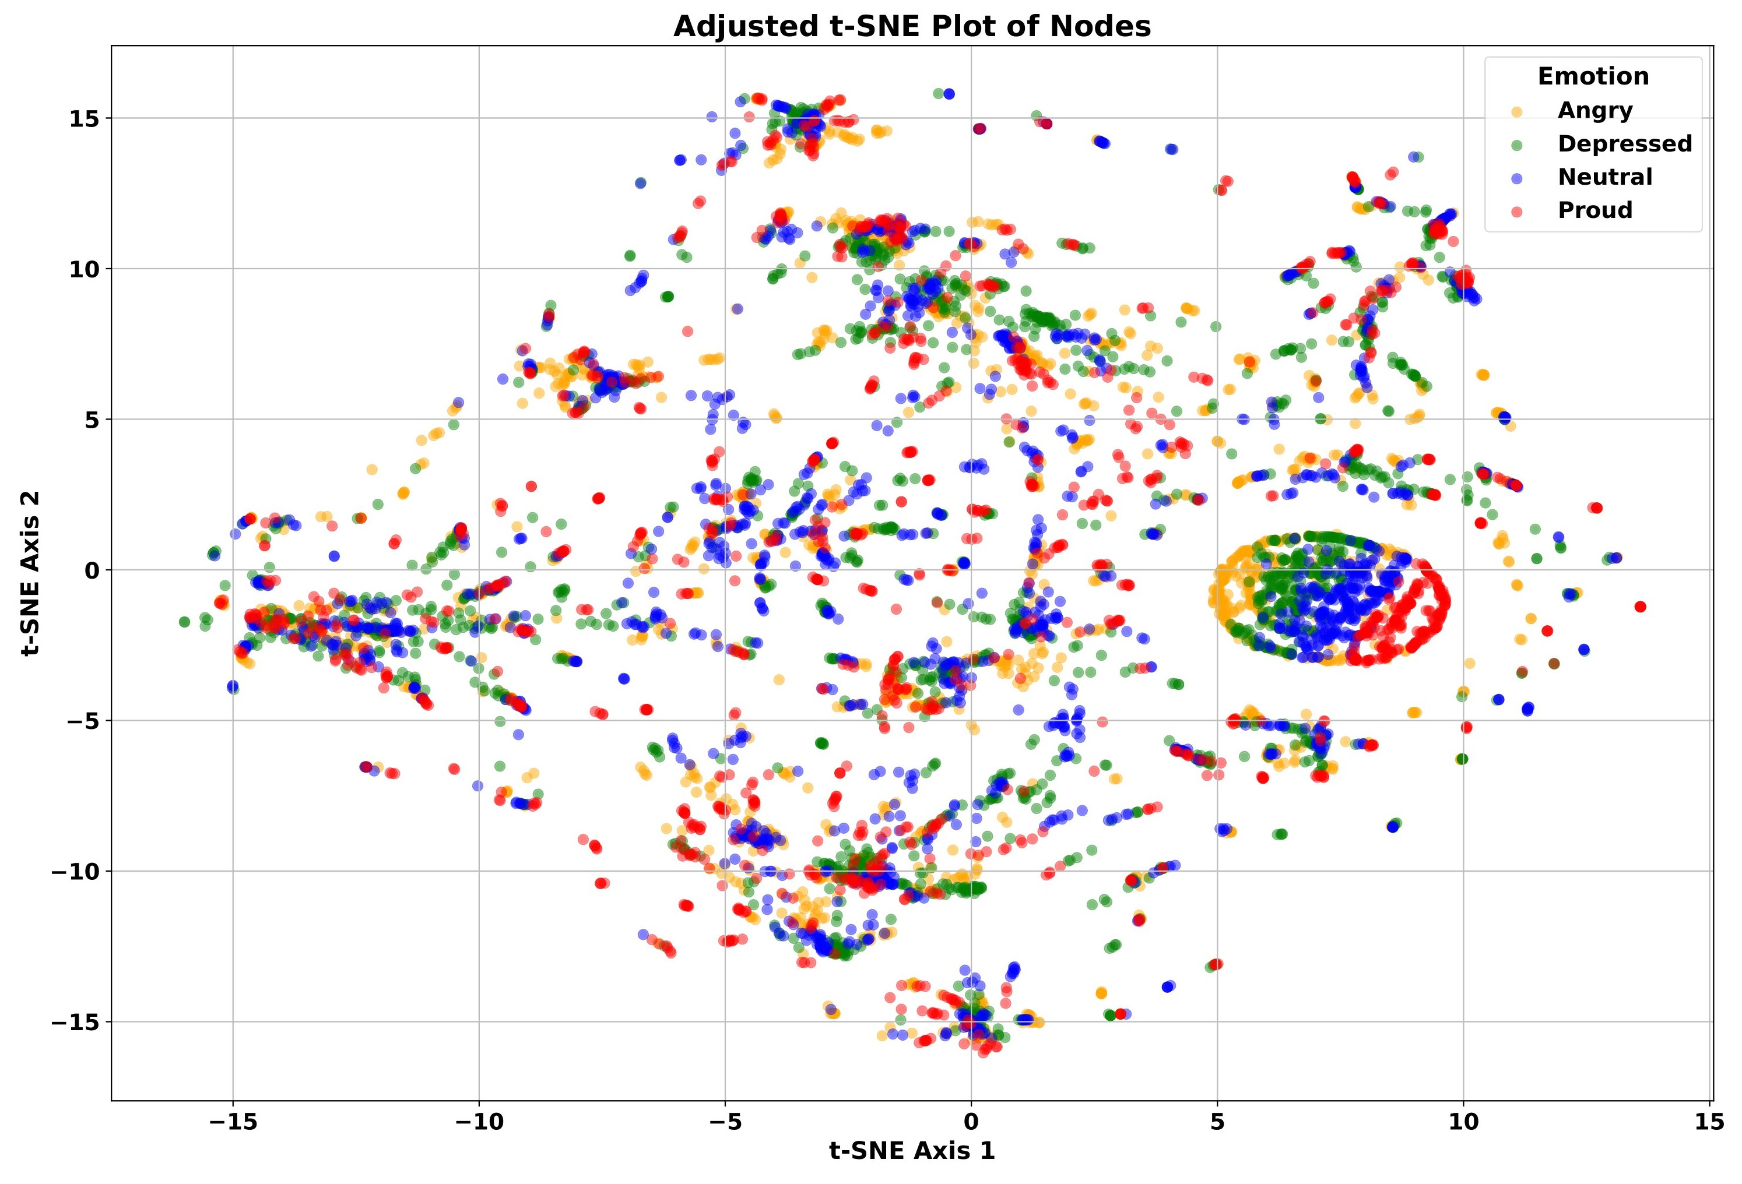
The Contribution
Emotion | Sample
Angry | 59
Depressed | 58
Neutral | 58
Proud | 47
Sum | 252
Nodes | 6882
Edges | 6660
Features | 2202

Slide 22
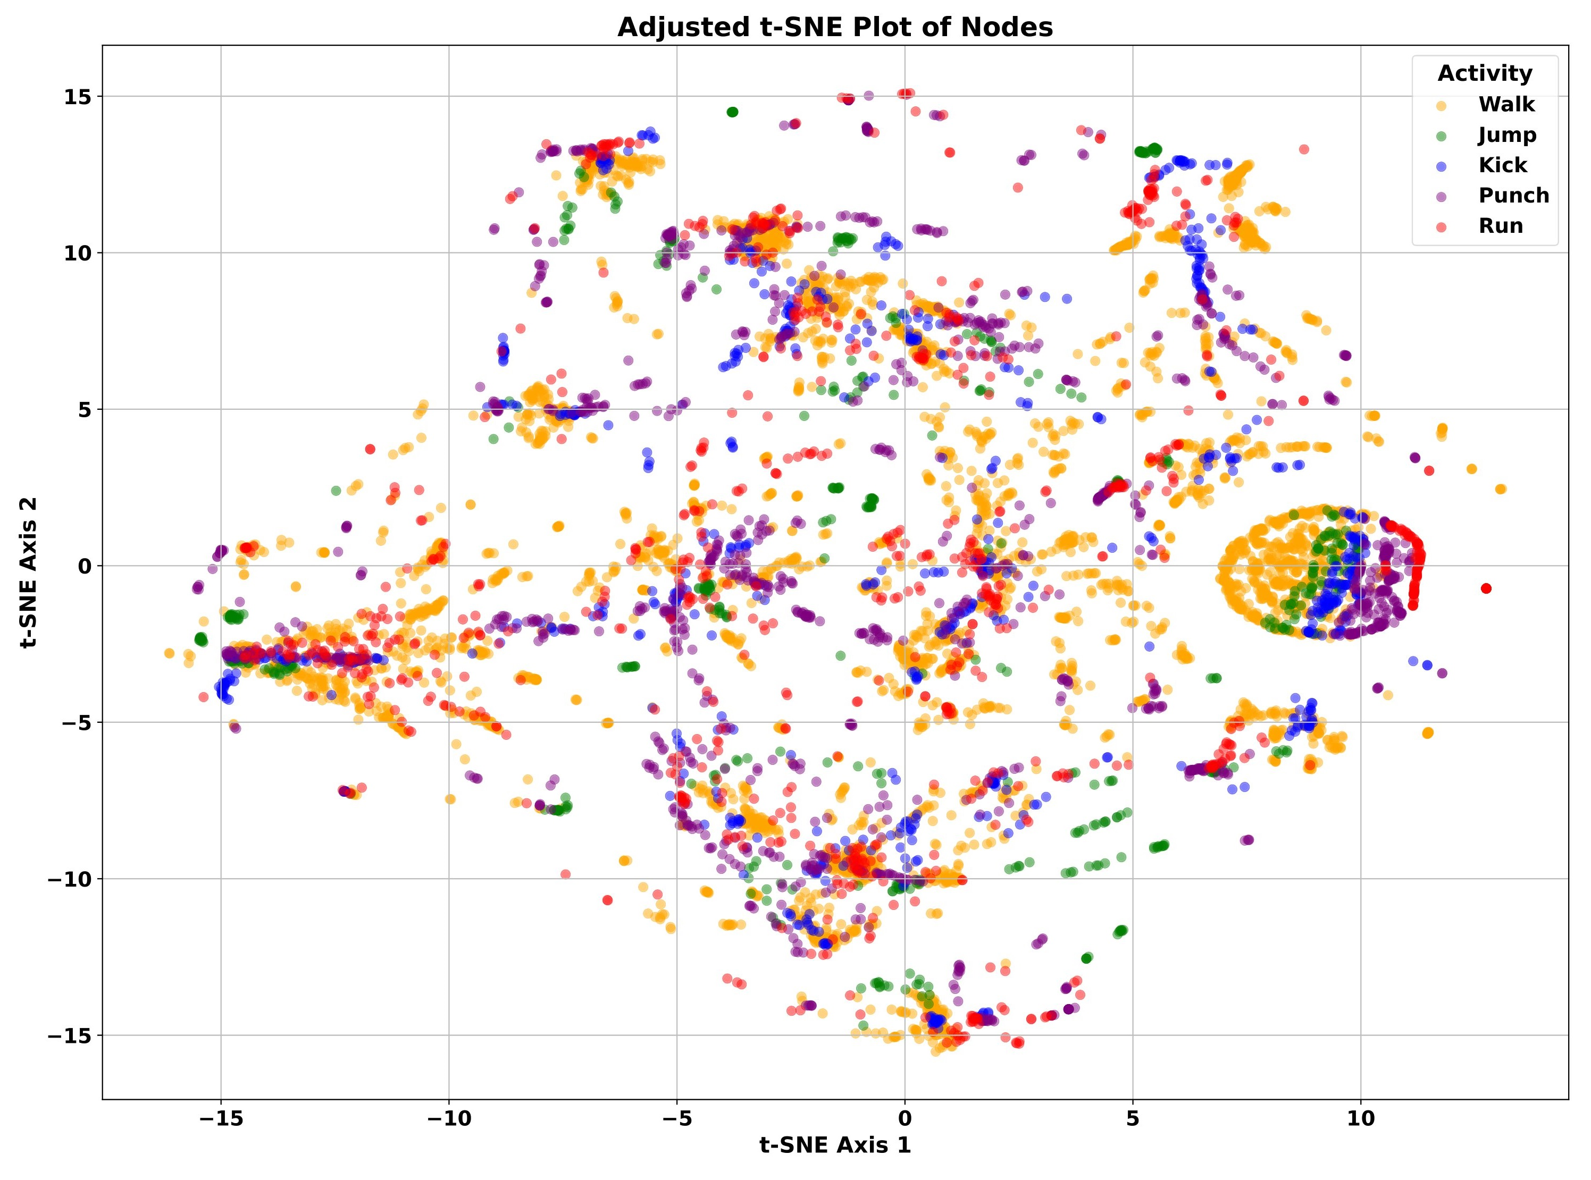
The Contribution
Activity | Sample
Walk | 135
Jump | 18
Kick | 25
Punch | 44
Run | 30
Sum | 252
Nodes | 7812
Edges | 7560
Features | 2202

Slide 23
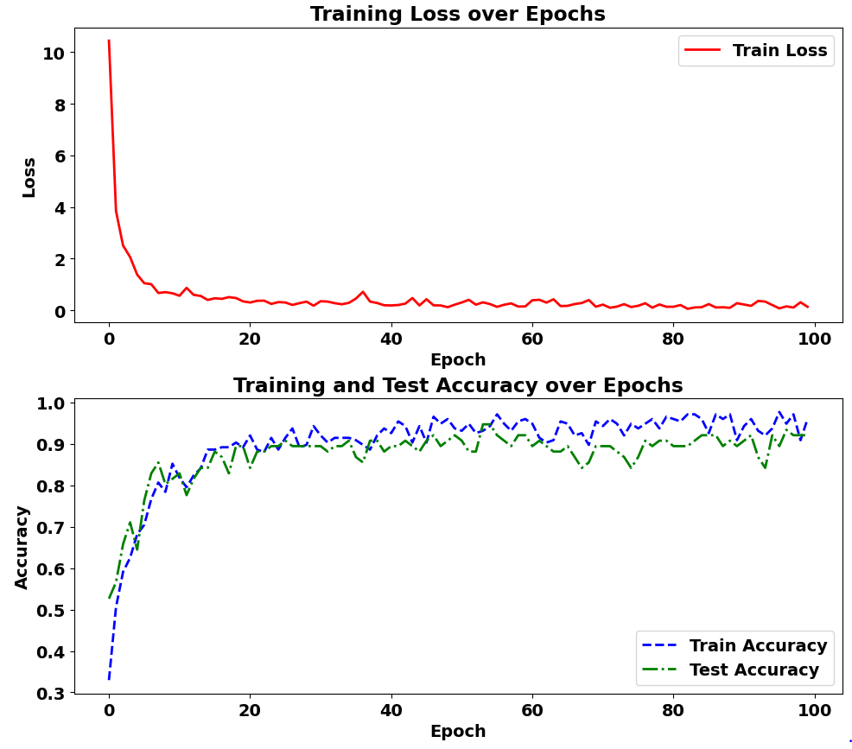
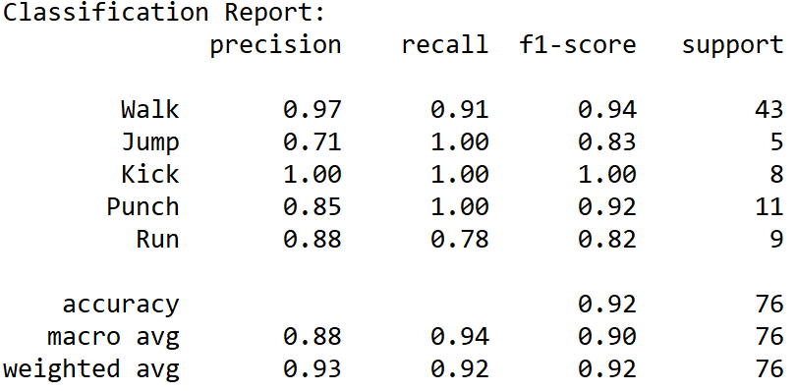
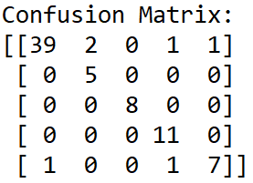

Results
Train Loss: 0.1319
Train Acc: 0.9602
Test Acc: 0.9211

Slide 24
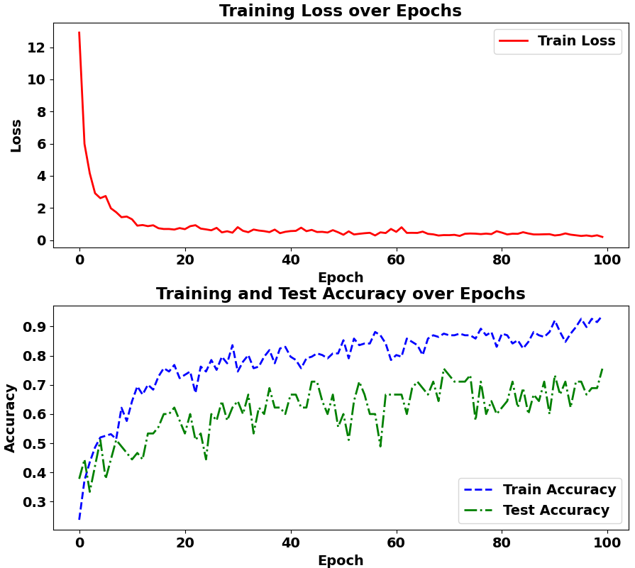
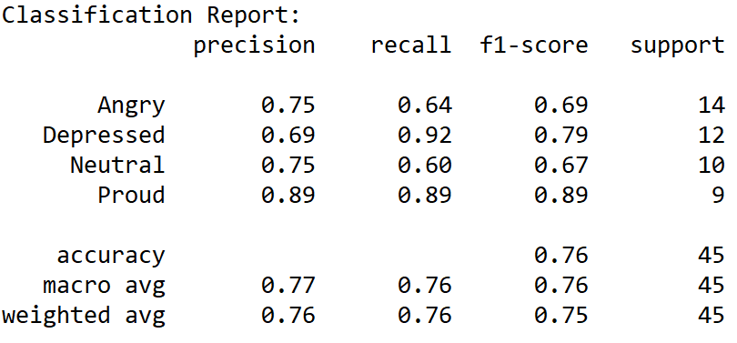
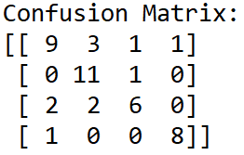
Results
Train Loss: 0.1959
Train Acc: 0.9379
Test Acc: 0.7556

Slide 25
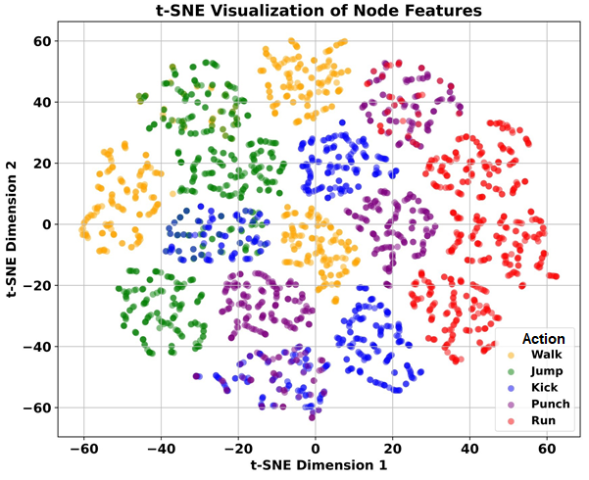
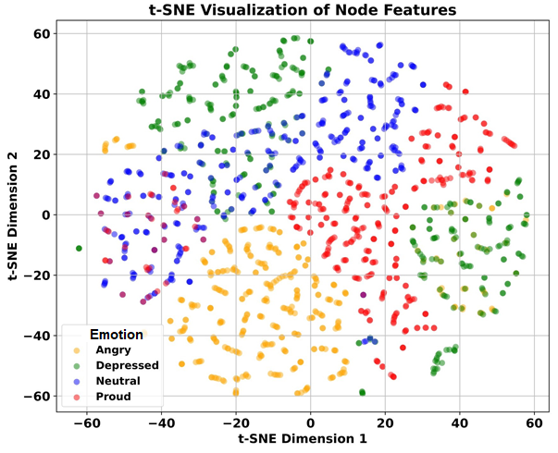
Results

Slide 26
Results

Slide 27
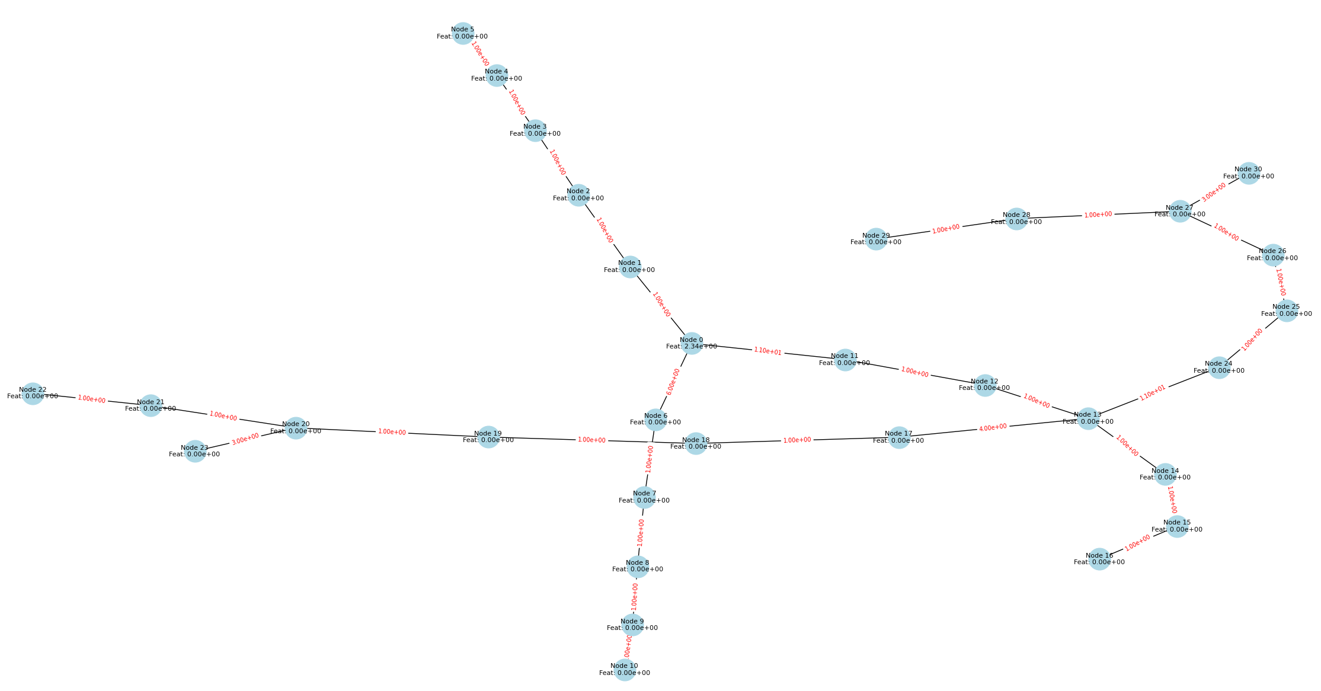
Results

Slide 28
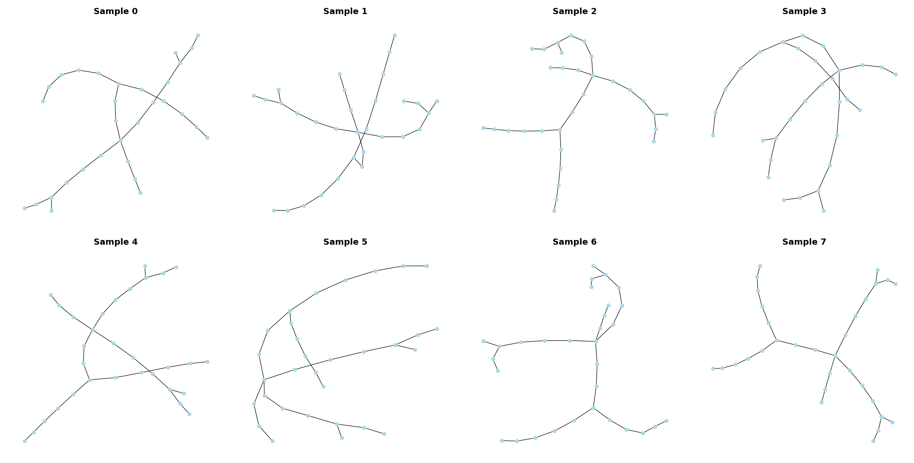
Results

Slide 29

References
[1]. Shi, Jiaqi, et al. "Skeleton-based emotion recognition based on two-stream self-attention enhanced spatial-temporal graph convolutional network." Sensors 21.1 (2020): 205.
[2]. Ahmed, Ferdous, ASM Hossain Bari, and Marina L. Gavrilova. "Emotion recognition from body movement." IEEE Access 8 (2019): 11761-11781.
[3]. Bota, Patricia J., et al. "A review, current challenges, and future possibilities on emotion recognition using machine learning and physiological signals." IEEE access 7 (2019): 140990-141020.
[4]. Picard, Rosalind W. Affective computing. MIT press, 2000.
[5]. https://www.cs.cityu.edu.hk/~howard/Teaching/CS4185-5185-2007-SemA/Group12/BVH.html
[6]. Kipf, Thomas N., and Max Welling. "Semi-supervised classification with graph convolutional networks." arXiv preprint arXiv:1609.02907 (2016).
[7]. Shi, Henglin, et al. "Multiscale 3D-shift graph convolution network for emotion recognition from human actions." IEEE Intelligent Systems 37.4 (2022): 103-110.
[8].Ghaleb, Esam, et al. "Skeleton-based explainable bodily expressed emotion recognition through graph convolutional networks." 2021 16th IEEE International Conference on Automatic Face and Gesture Recognition (FG 2021). IEEE, 2021.

Slide 30



